Slide 1

Xen and Virtualization
-B.Vamsi Viswanath
137111
-Y.Mahendra Kumar
137167
-Dr.Swathi Kiran Kumar
137119

Slide 2
VIRTUALIZATION
Virtualization is the ability to run multiple operating systems on a single physical system and share the underlying hardware resources
It is the process by which one computer hosts the appearance of many computers.
Virtualization is used to improve IT throughput and costs by using physical resources as a pool from which virtual resources can be allocated.

Slide 3
Motivation
Stronger isolation between applications
  Using separate machines is too expensive
  Separate processes is not sufficient
Excess computing power
Different OSs on the same machine

Slide 4
Virtualization & the Challenges
Speed & Performance
Security
  Resource Isolation
Functionality
Access to remote resources
Xen & its target
  The authors came up with the design goal of being able to run 100 simultaneous virtual machine implementations with Binary Compatibility

Slide 5
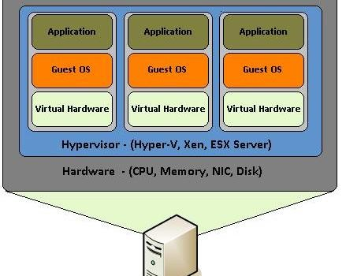
TYPICAL DESIGN OF VIRTUALIZATION

Slide 6
2 TYPES OF VIRTUALIZATION
1. PARAVIRTUALIZATION
2. FULL VIRTUALIZATION

Slide 7
PARAVIRTUALIZATION
Paravirtualization is virtualization in which the guest operating system (the one being virtualized) is aware that it is a guest and accordingly has drivers that, instead of issuing hardware commands, simply issue commands directly to the host operating system. This also includes memory and thread management as well, which usually require unavailable privileged instructions in the processor.

Slide 8
FULL VIRTUALIZATION
Full Virtualization is virtualization in which the guest operating system is unaware that it is in a virtualized environment, and therefore hardware is virtualized by the host operating system so that the guest can issue commands to what it thinks is actual hardware, but really are just simulated hardware devices created by the host.

Slide 9
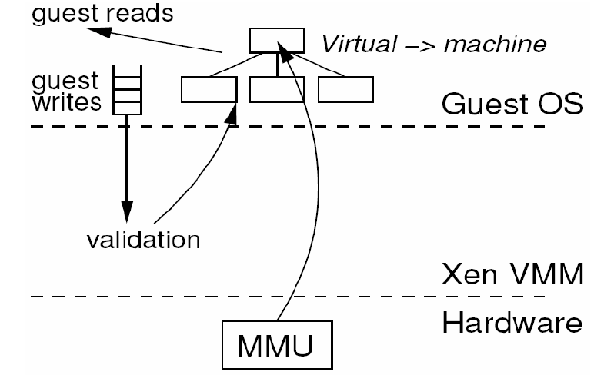
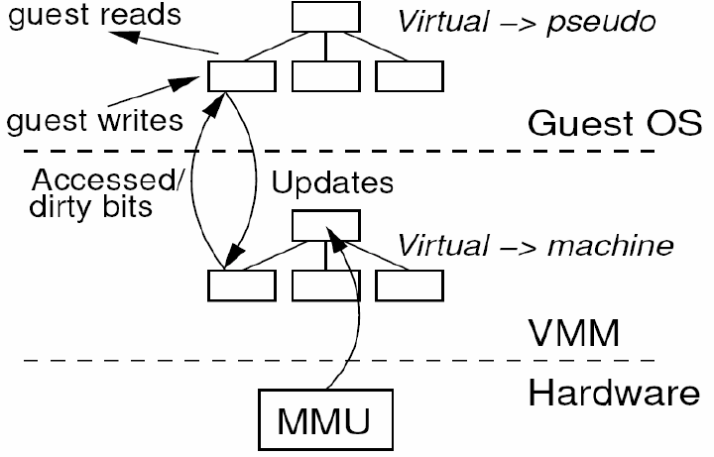
Paravirtualization of the MMU
Paravirtualization
Full Virtualization
Diagrams provided by a presentation from the Universität Karlsruhe

Slide 10
DIFFERENT VIRTUAL MACHINES
Kernel-based Virtual Machine (KVM) is a virtualization infrastructure for the Linux kernel that turns it into a hypervisor
VMware, Inc. is a subsidiary of Dell Technologies that provides cloud and virtualization software and services.
Xen Project is a hypervisor using a microkernel design, providing services that allow multiple computer operating systems to execute on the same computer hardware concurrently

Slide 11
Generally KVM and VMWARE are Full virtualized and XEN is Paravirtualized.

Slide 12
What is XEN?
Xen makes it possible for multiple guest operating systems to run on a single computer by using a software layer called a hypervisor to mediate access to the real hardware. The hypervisor acts like a traffic cop, directing hardware access and coordinating requests from the guest operating systems.

Slide 13
Xen’s Approach
Instead of making the virtual machine 100% functionally identical to the bare hardware, Xen makes use of Paravirtualization
Paravirtualization is a process where the guest operating system is modified to run in parallel with other modified systems, and is designed to execute on a virtual machine that has a ‘similar’ architecture to the underlying machine.
  Pros:
    Allows for improved performance
  Cons:
    The hosted operating system must undergo modification before it can be hosted by the Xen Hypervisor (this can be a bit of a challenge)

Slide 14
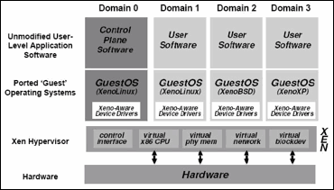
XEN DESIGN

Slide 15
XEN COMPONENTS
A Xen virtual environment consist of several items that work together to deliver the virtualization environment a customer is looking to deploy:
Xen Hypervisor
Domain 0
Domain Management and Control (Xen DM&C)
Domain U (Dom U) PV Guest
Domain U (Dom U) HVM Guest

Slide 16
HYPERVISOR
Xen Hypervisor
The Xen hypervisor is the basic abstraction layer of software that sits directly on the hardware below any operating systems. It is responsible for CPU scheduling and memory partitioning of the various virtual machines running on the hardware device. The hypervisor not only abstracts the hardware for the virtual machines but also controls the execution of virtual machines as they share the common processing environment.

Slide 17
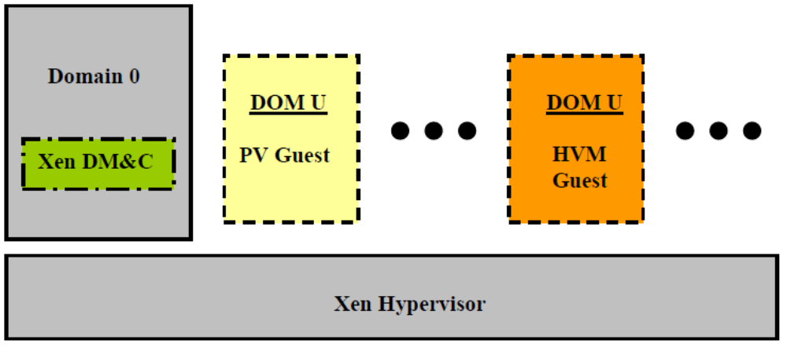
HYPERVISOR

Slide 18
Domain 0
Domain 0, a modified Linux kernel, is a unique virtual machine running on the Xen hypervisor that has special rights to access physical I/O resources as well as interact with the other virtual machines (Domain U: PV and HVM Guests) running on the system. All Xen virtualization environments require Domain 0 to be running before any other virtual machines can be started.

Slide 19
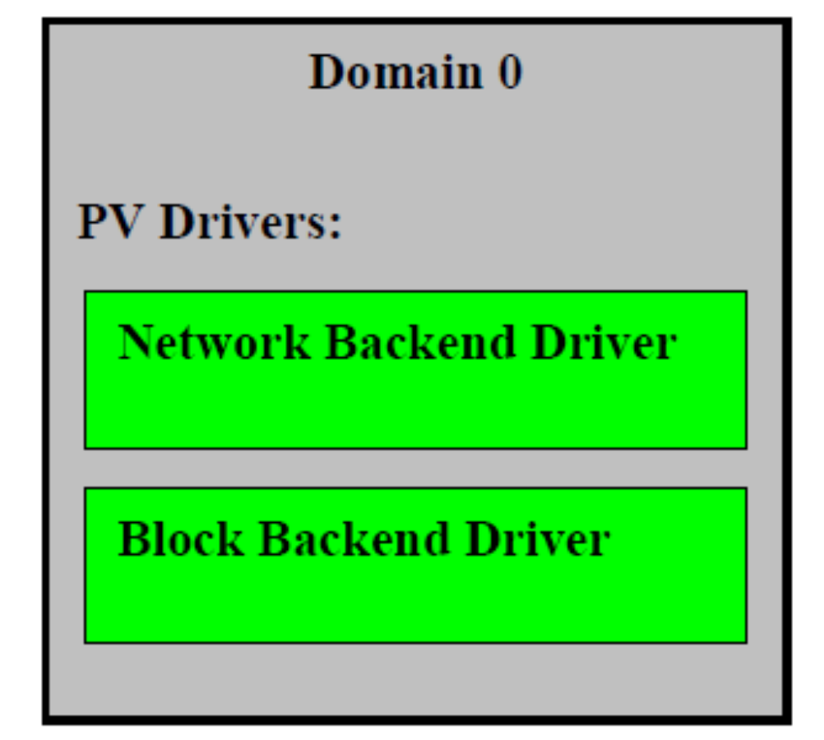
DOMAIN 0

Slide 20
DOMAIN U
Domain U
All paravirtualized virtual machines running on a Xen hypervisor are referred to as Domain U PV Guests and are run modified Linux operating systems, Solaris, FreeBSD, and other UNIX operating systems. All fully virtualized machines running on a Xen hypervisor are referred to as Domain U HVM Guests and run on standard Windows or any other unchanged operating system. The Domain U PV Guest virtual machine is aware that it does not have direct access to the hardware and recognizes that other virtual machines are running on the same machine. The Domain U HVM Guest virtual machine is not aware that it is sharing processing time on the hardware and that other virtual machines are present.

Slide 21
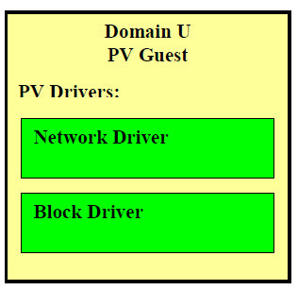
DOMAIN U

Slide 22
Domain 0 to Domain U Communication
As stated earlier, the Xen hypervisor is not written to support network or disk requests thus a Domain U PV Guest must communicate via the Xen hypervisor with the Domain 0 to accomplish a network or disk request. The example presented below shows a Domain U PV Guest writing data to the local hard disk. The Domain U PV Guest PV block driver receives a request to write to the local disk and writes the data via the Xen hypervisor to the appropriate local memory which is shared with Domain 0. An event channel exists between Domain 0 and the Domain U PV Guest that allows them to communicate via asynchronous inter-domain interrupts in the Xen hypervisor. Domain 0 will receive an interrupt from the Xen hypervisor causing the PV Block Backend Driver to access the local system memory reading the appropriate blocks from the Domain U PV Guest shared memory. The data from shared memory is then written to the local hard disk at a specific location.

Slide 23
Domain 0 to Domain U Communication
The event channel is shown below as a direct link between Domain 0 and Domain U PV Guest which is a simplified view of the way the system works. In fact, the event channel runs through the Xen hypervisor with specific interrupts registered in Xenstored allowing both the Domain 0 and Domain U PV Guest to quickly share information across local memory.

Slide 24
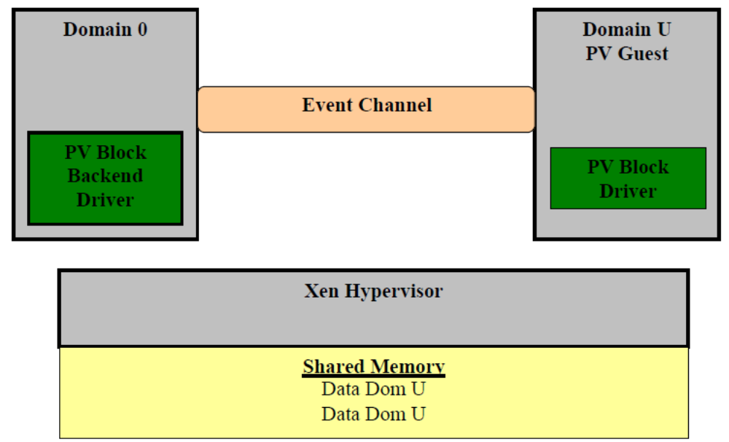
Domain 0 to Domain U Communication

Slide 25
GITHUB LINK
https://github.com/swathikirankumar/xen

